Slide 1
Molecular Docking
Jack Ustanik

Slide 2
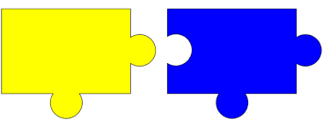
Molecular Docking Overview
Computational method that predicts the binding of ligands to a macromolecule
2 Step process
Generating a potential ligand binding mode
Position and Orientation of ligand is predicted within the binding site
Uses specific algorithm to try and find the most optimal binding site
Scoring the model by assessing binding affinity
Models from the previous step are scored based upon how well they fit in the binding site

Slide 3
Molecular Docking terms
Grid box is the set space that a ligand searches to bind at
Conformational searching is the process of producing multiple conformations and orientations of the ligand withing the grid box
Each conformation has a ranked score based on the binding energy or affinity of each ligand
Factors impacting docking include nonbonded interactions: Electrostatics, van der Waals, hydrogen bonding, and hydrophobic interactions
Molecular Docking is a useful in drug discovery and design

Slide 4
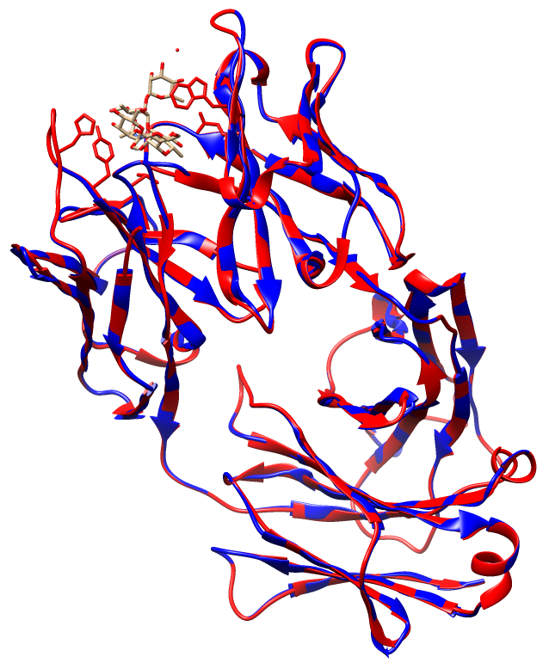
Our System
1m7I is the protein that we will be working with (CRYSTAL STRUCTURE OF A MONOCLONAL FAB SPECIFIC FOR SHIGELLA FLEXNERI Y LIPOPOLYSACCHARIDE COMPLEXED WITH A PENTASACCHARIDE)
The ligand is a pentasaccharide fragment of the Shigella Flexneri polysaccharide fragment
Prior to docking the 1m7I file was edited to make sure chain A (light chain) is in front of chain B (heavy chain), and should contain nothing else

Slide 5
Autodock Vina vs Vina Carb
Autodock Vina is a hype of software that is used for molecular docking simulations
Vina Carb is a modified version of Autodock Vina which improves Glycosidic angles during docking
Considers more structural features and flexibility
VinaCarb includes additional CHI energy functions
CHI-energy weight term and CHI-energy cutoff term
In our procedure VinaCarb was used for docking

Slide 6
Procedure
Slight editing to file to make the process more efficient
Upload file to GLYCAM website to perform docking
Proceed through steps to perform docking with some parameters of interest
Perform two types of RMSD calculations to evaluate docked complexes
Pose RMSD (PRMSD) and Shape RMSD (SRMSD)
Evaluate models and results

Slide 7
Input information
Grid Box
Center of docking Grid
Dimensions of the Grid
X=32.0 Y=32.0 Z=36.0
32x32x36 (Angstroms)
Bigger: More conformations and more time
Smaller: Miss conformations less complexity
Number of different binding conformations: 20
More: Higher accuracy and more time
Less: Lower accuracy and less time
receptor = protein.pdbqt
ligand = ligand.pdbqt
center_x = 0.0
center_y = 0.0
center_z = 11.0
size_x = 32.0
size_y = 32.0
size_z = 36.0
energy_range = 10
num_modes = 20
chi_coeff=1
chi_cutoff=2

Slide 8
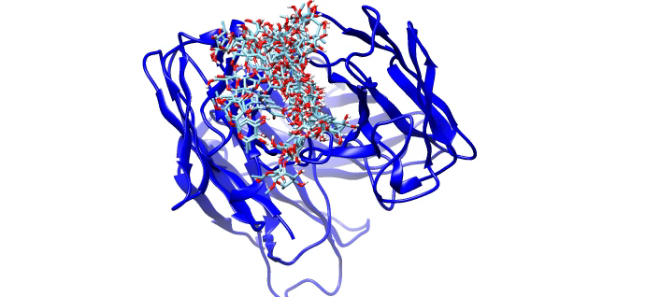
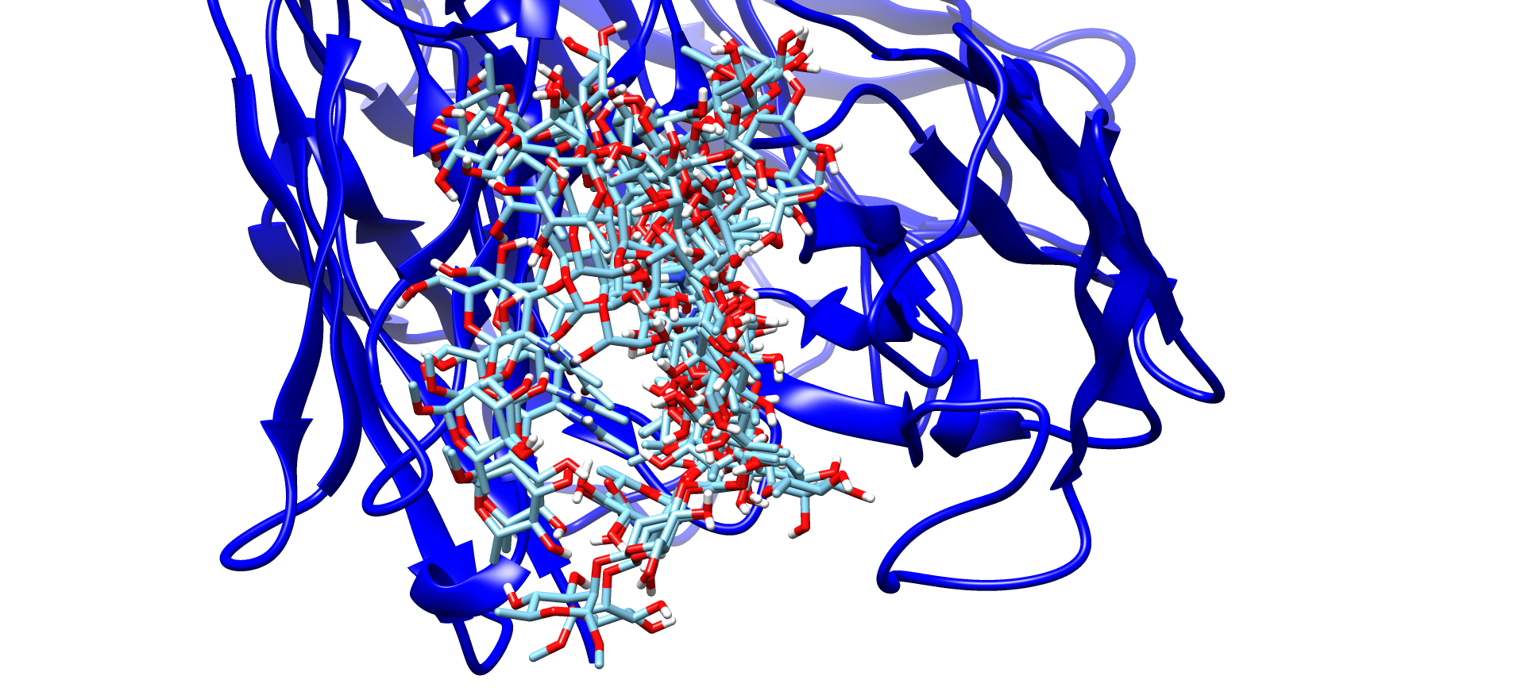
Modeled Docking Result
scfv_aligned.pdb
docking_output.pdb
All 20 ligands bind in a similar position
Docking occurs in the same general location due to grid box, favorable interactions, shape, and flexibility

Slide 9
Shape and Position RMSD
Shape RMSD (SRMSD) and Pose RMSD (PRMSD) are measurements that determine the structural similarity between structures
SRMSD measures the deviation of shape and volume of molecules
Low value indicates that there is a similar shape and size of reference and predicted structures
PRMSD measures the deviation of atoms of molecules or a molecule before and after binding
Difference between predicted positions from the reference structure
Lower values indicate the predicted structure is similar to the reference structure

Slide 10
Accuracy of Docking with RMSD
Average Pose RMSD: 9.7962
Average Shape RMSD: 1.17

Slide 11
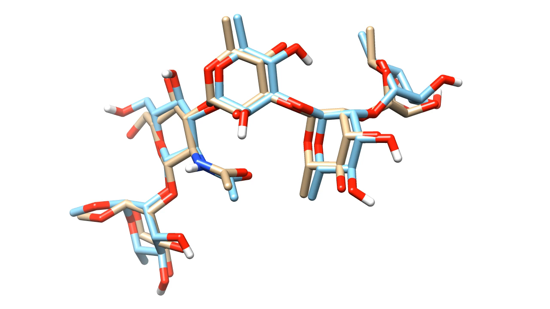
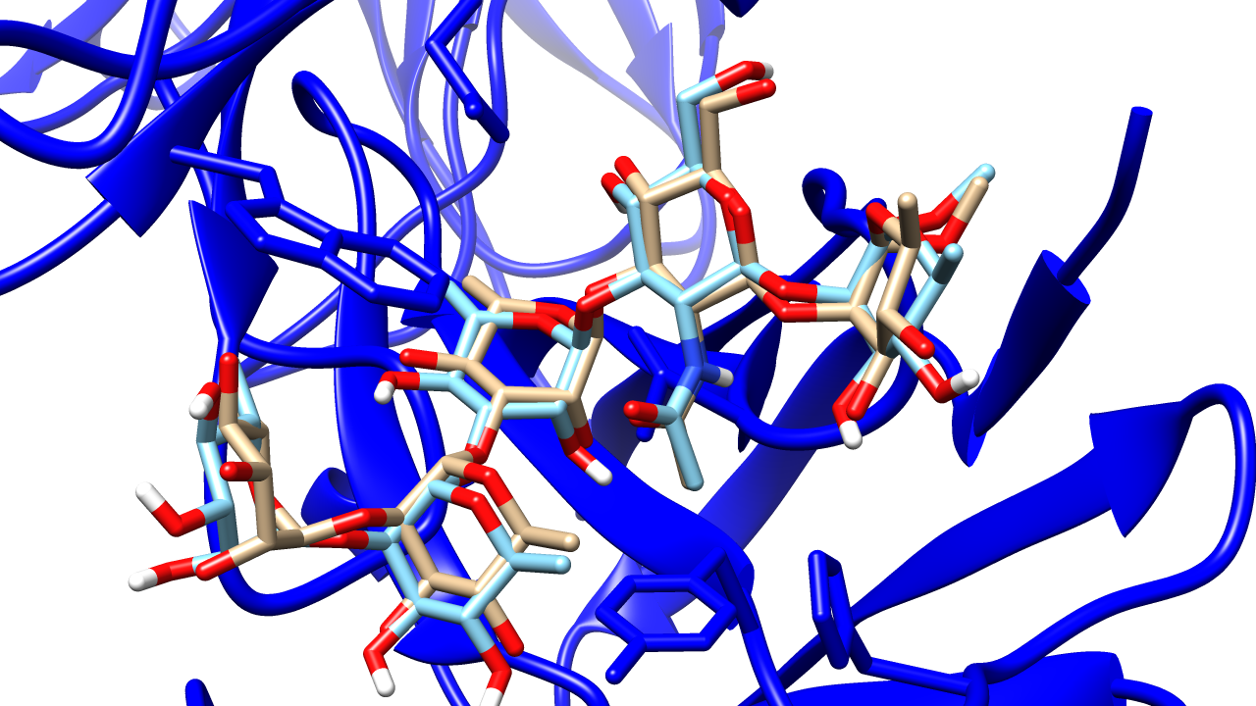
Most accurate ligand with reference ligand
Depicted is the most accurate docking model overlaid with the reference ligand
Similar but different position

Slide 12
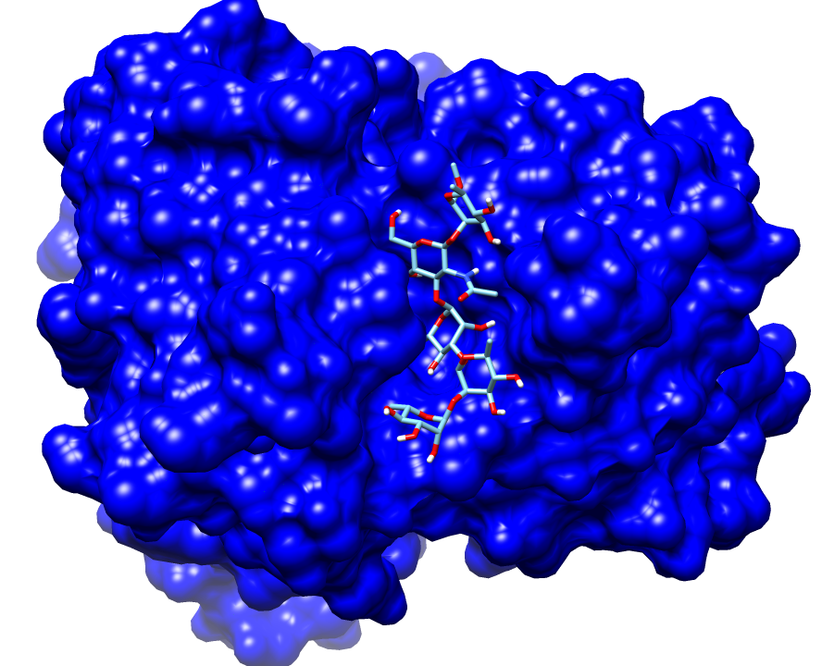
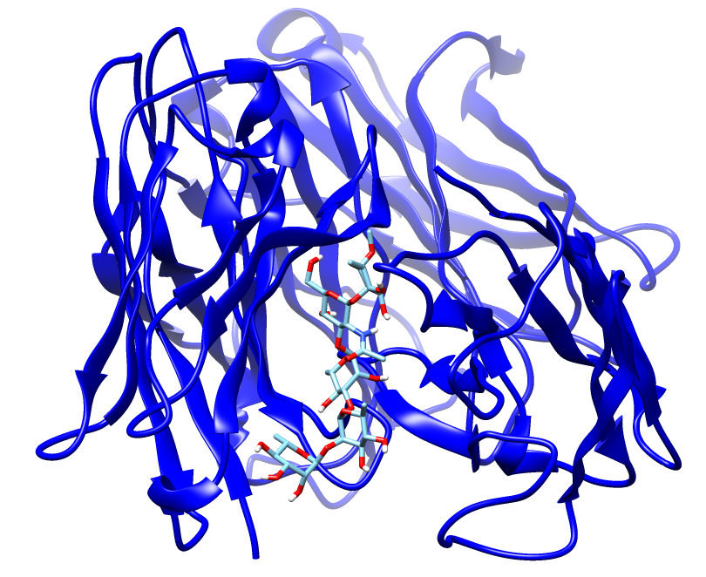
Pictures of best docked model
Ligand positioned in binding site

Slide 13
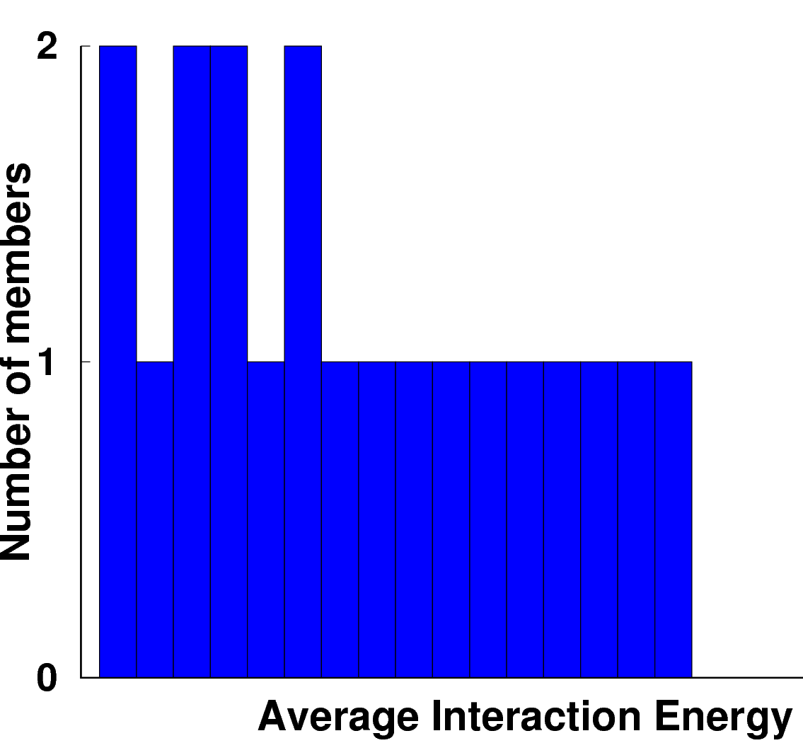
Clustering and Energies
Energy Increasing
Interaction Energy (kcal/mol)

Slide 14
Hydrogen Bonding Impact
Hydrogen Bonding present in the following models:
1, 2, 8, 9, 10, 11, 13, 14, 15, 17, 19, 20
What does this tell us about hydrogen bonding?

Slide 15
Conclusions
Molecular docking is a computational method used to predict how well ligands can bind macromolecules
Applications of docking include drug discovery and structural biology
Varied conformations/orientations of ligands produce levels of docking accuracy
PRMSD and SRMSD can be used to help make docking accuracy predictions
Interaction energies measure the strength of ligand-protein binding

